Slide 1
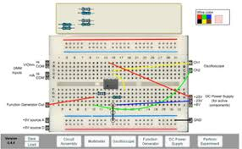
VIRTUAL ELECTRONICS LAB
Final review of Internship on
Presented by,
G SHRUTHI SASTRY
1DS17LDN02
M.Tech – DCN, III Sem, DSCE
Internal Guide
Dr. SMITHA SASI
Assistant Professor
Dept. Of TCE, DSCE
External Guide
Mr. RAJU CHALUVA
CEO
Duxes Labs Pvt. Ltd
Digital Communication and Networking, Department of TCE, Dayananda sagar college of engineering, Shavige Malleshwara hills, Kumaraswamy layout, Bengaluru

Slide 2
CONTENTS
About the company
Abstract
Block diagram of V-lab
Modular approach
Work done during the internship
File operations
GUI
Drag and drop feature
Multisim tool
Summary
Hardware description

Slide 3

ABOUT THE COMPANY
Duxes Labs Pvt. Ltd. has been established as an Electronics Company in Bangalore in 2012. The traditional business model is based on developing products as per the requirement of the Clients.
The work profile includes
1. Robotics 2. Automation 3. Software development 4. Embedded systems 5. Website development
DUXES LABS PVT LTD

Slide 4
INTRODUCTION
Virtual labs provide a remotely operated lab environment for students to perform experiments.
This can be useful in testing the equipments and devices remotely for R&D .
In order to achieve this kind of remote access both hardware and software infrastructure support is needed.
The hardware infrastructure may be comprising of electrical components that are controlled from the controller.
The software infrastructure must allow remote commanding .

Slide 5
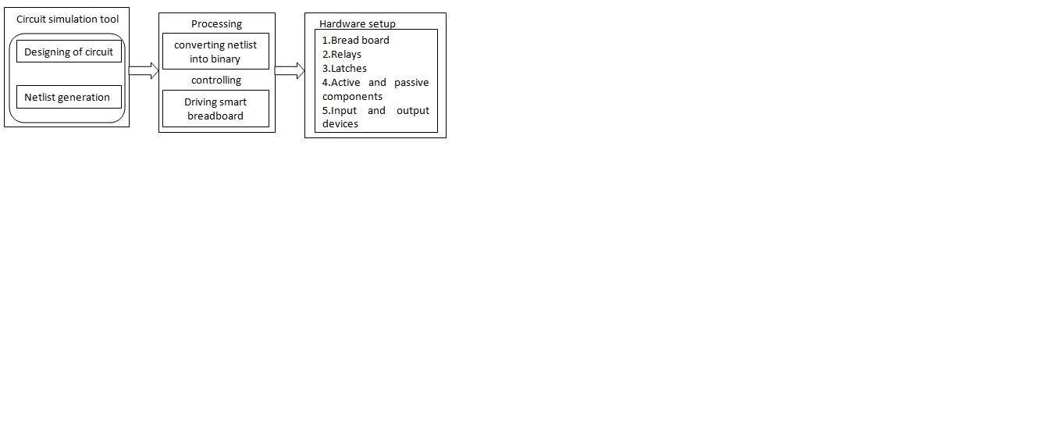
BLOCK DIAGRAM OF VIRTUAL ELECTRONICS LAB
A client can login to the V-lab website from the remote place and access the tool to design the test circuit.
At the server end, the circuit is rigged up in a smart way without any human intervention and output is made visible to the client with the help of video conferencing.
This feature of testing and analyzing the circuits virtually, from the remote place is said to be virtual electronics lab.

Slide 6
Modular approach
Development of API
Circuit designing tool
Python communication
Physical lab setup
Smart breadboard
Web development
Database management

Slide 7
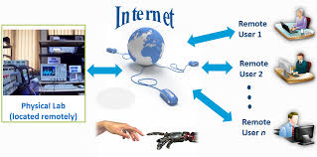
Analysis of project requirements
Python software for programming- Pycharm
Circuit designing tool- Multisim
Network programming in Python for sending netlist
Arduino programming for accessing netlist
Hardware setup for smart breadboard

Slide 8
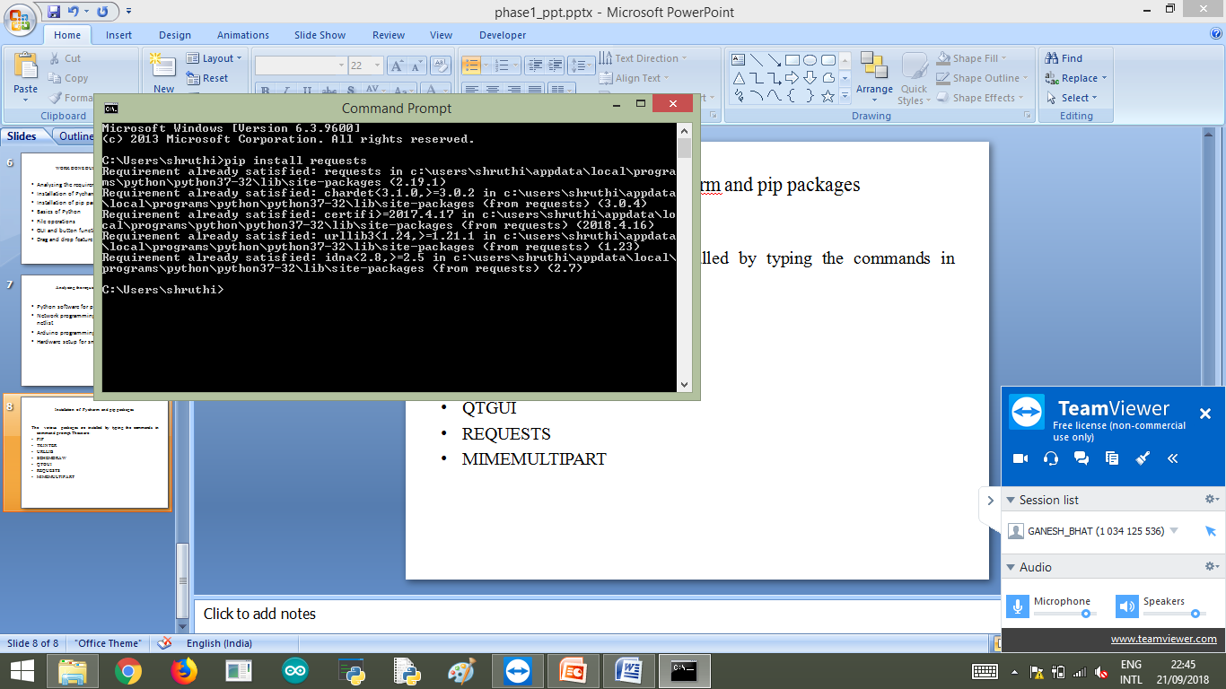
Installation of Pycharm and pip packages
The various packages are installed by typing the commands in command prompt. These are:
PIP
TKINTER
URLLIB
SCHEMDRAW
QTGUI
REQUESTS
MIMEMULTIPART

Slide 9
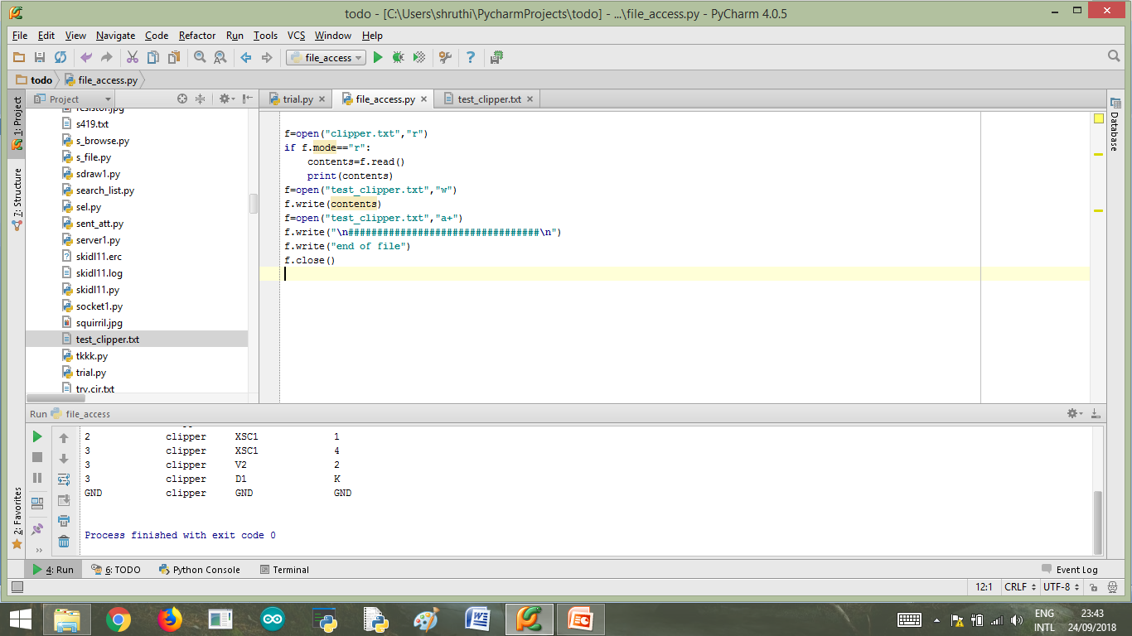
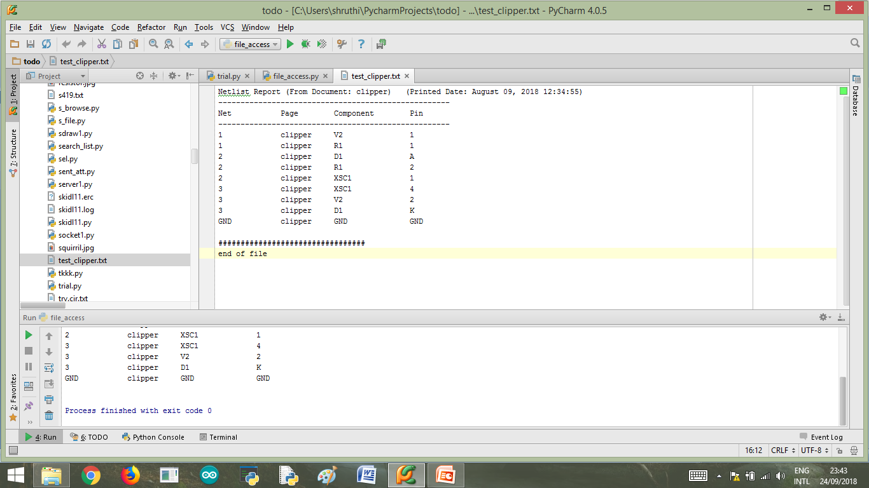
FILE ACCESS

Slide 10
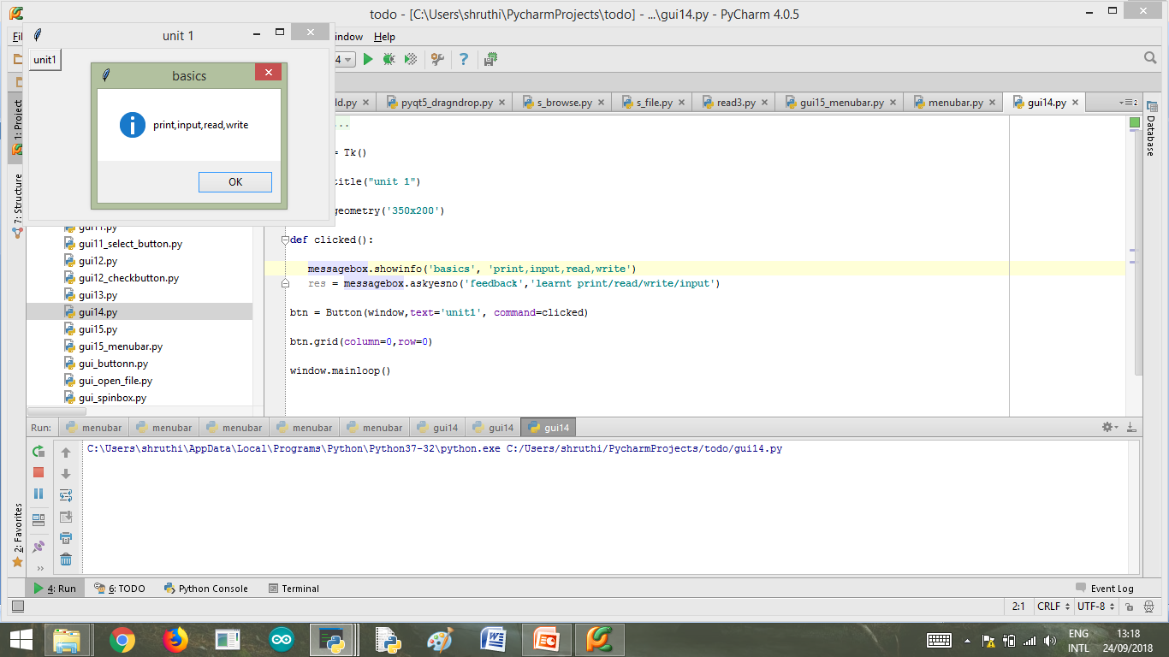
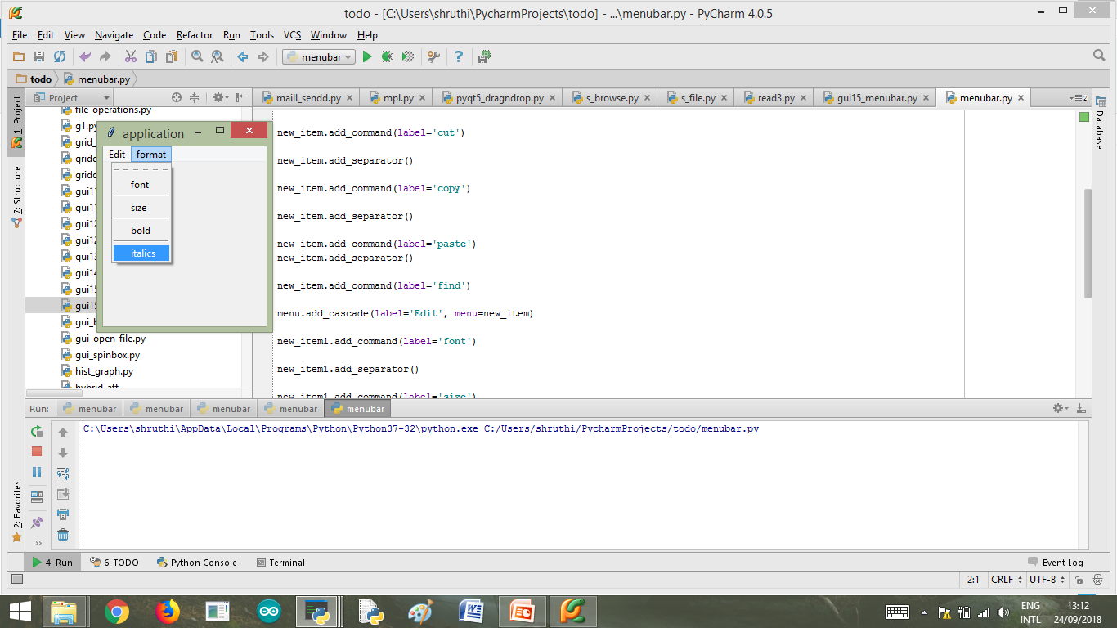
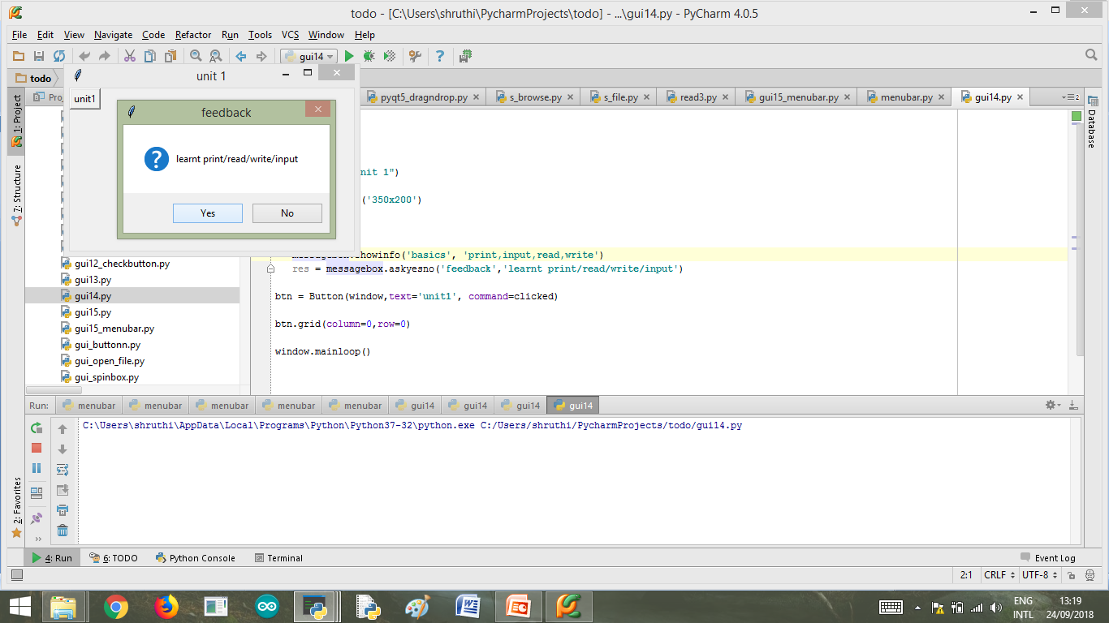
GUI (BUTTON function)
Menubar
Message box

Slide 11
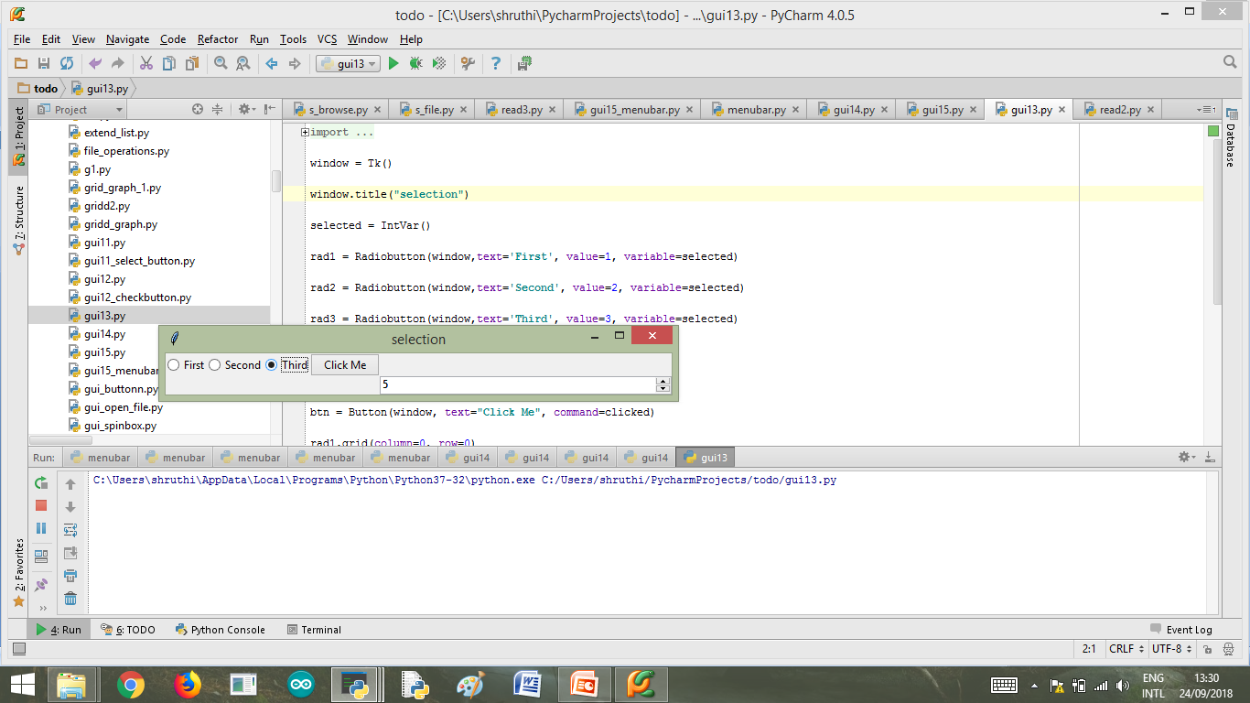
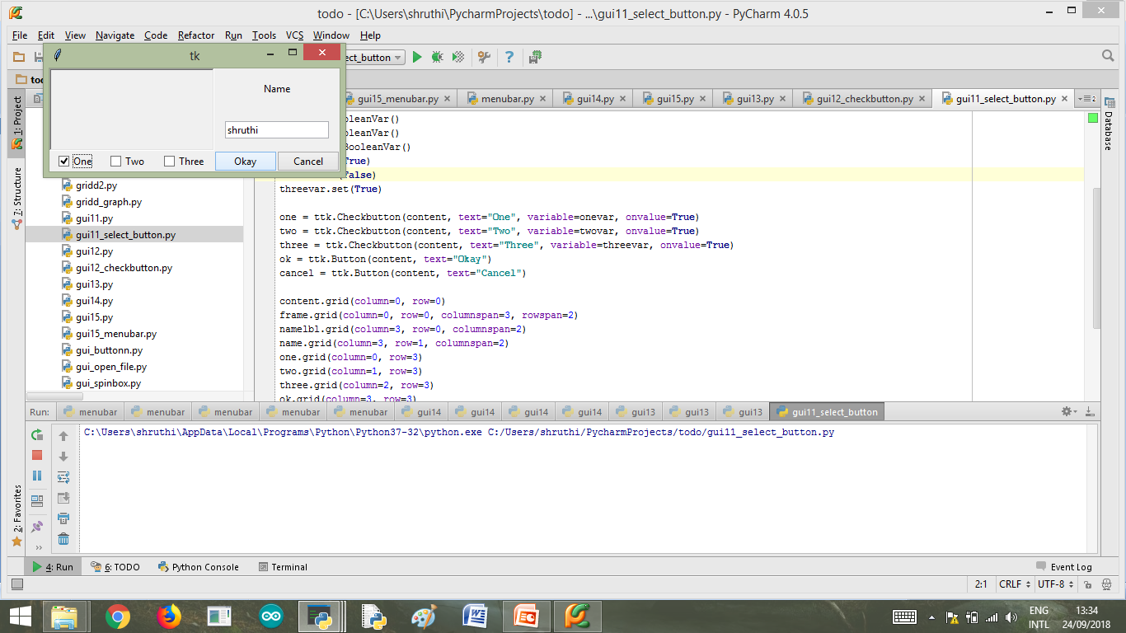
Radio button and spin box
Checkbutton and text widget

Slide 12
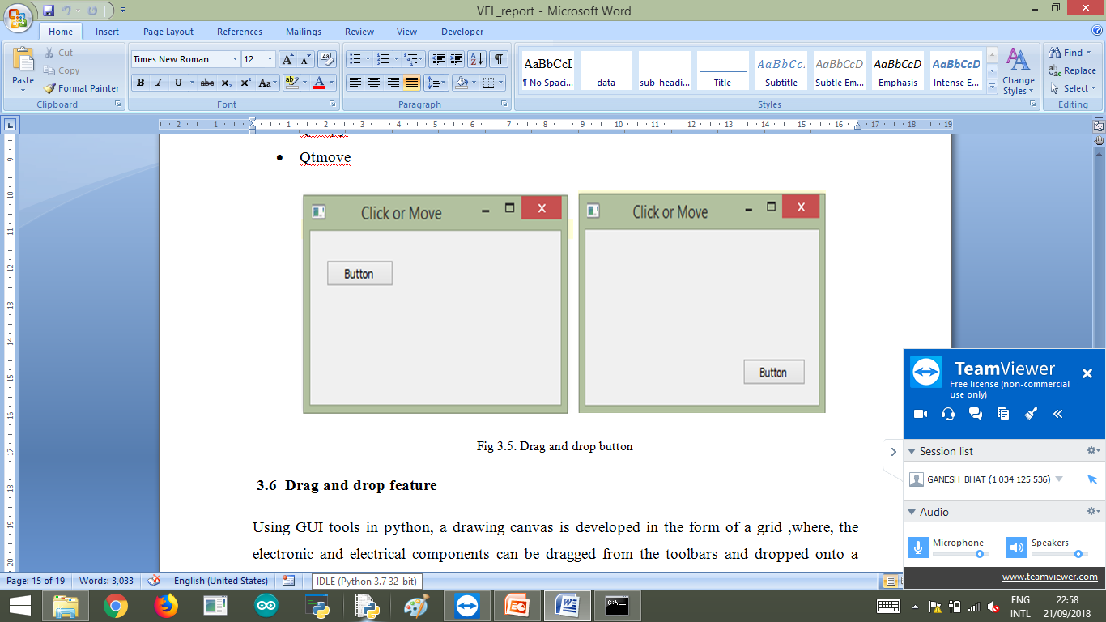
Drag and drop feature

Slide 13
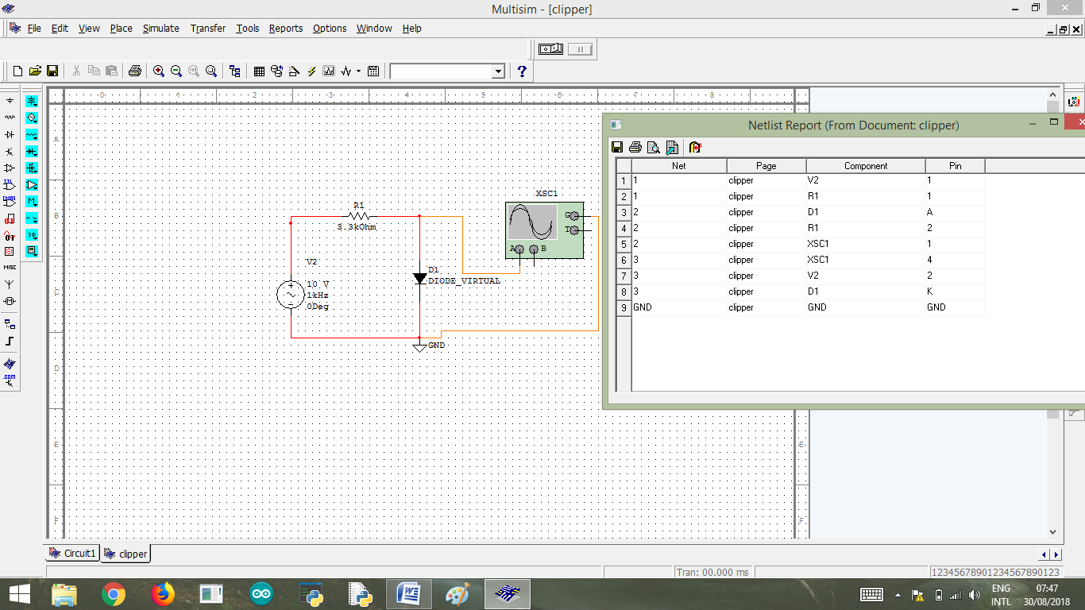
Multisim
Circuit designing and generating netlist

Slide 14
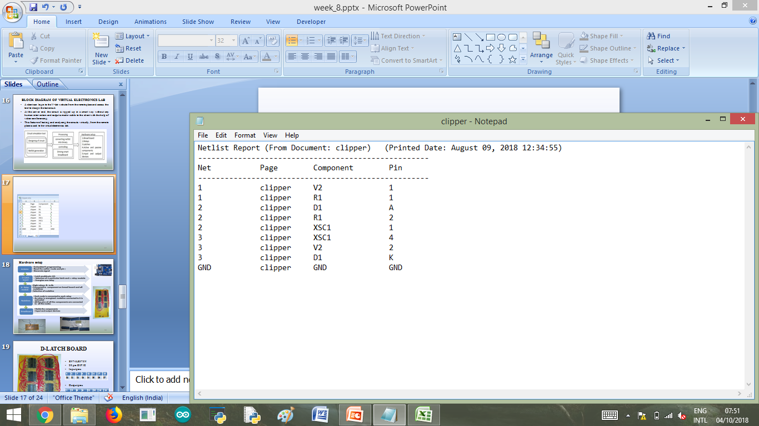

Slide 15
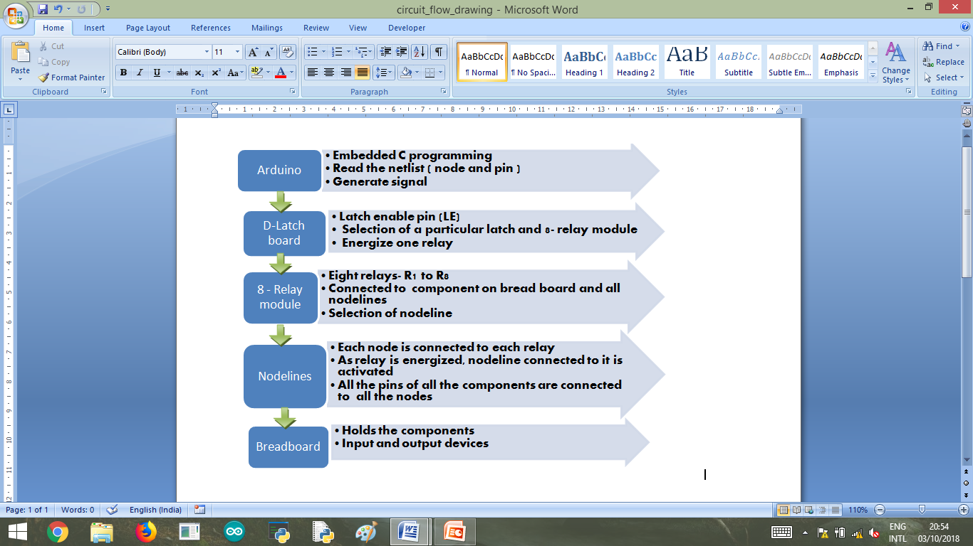
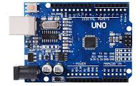
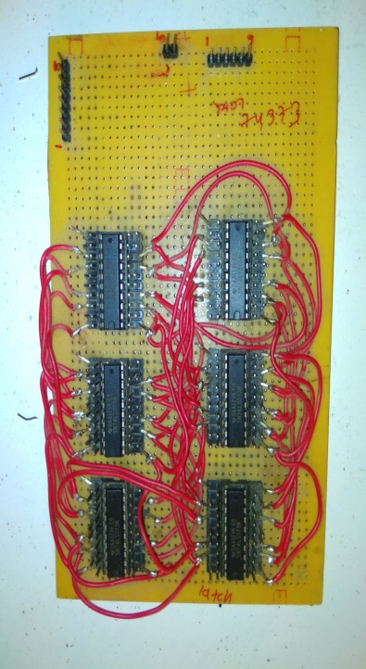
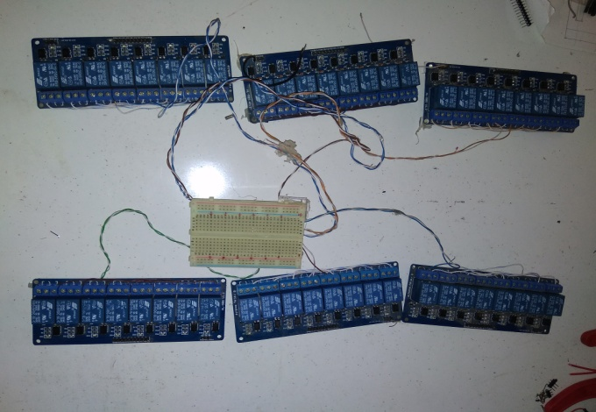
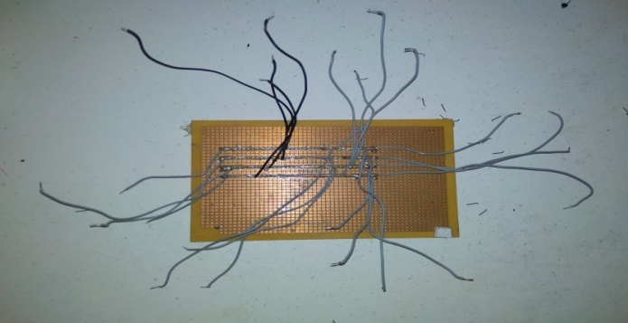
Hardware setup

Slide 16
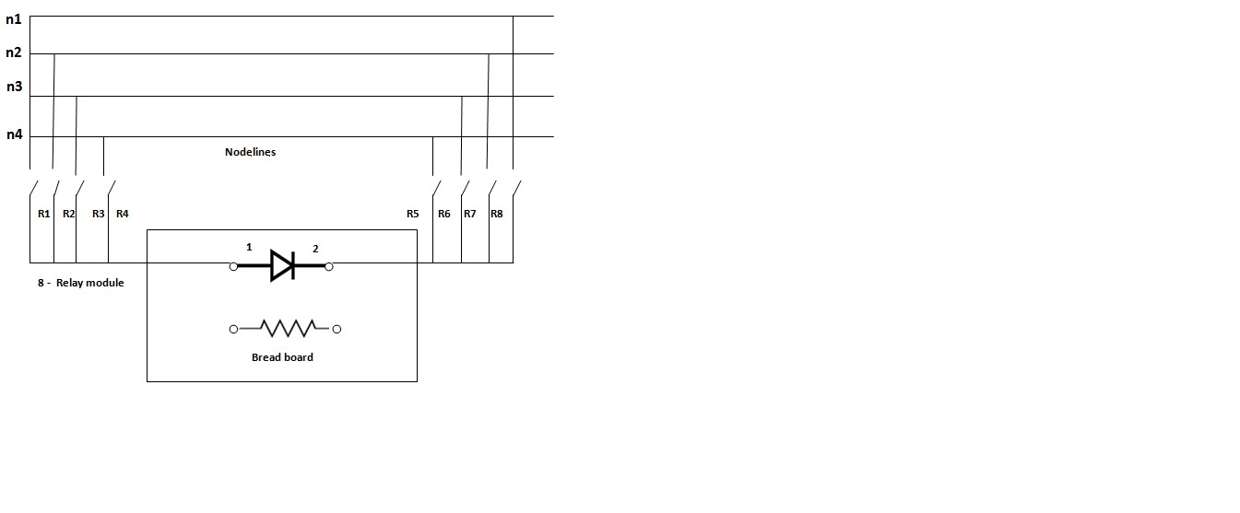
Interfacing of nodes and components by relay

Slide 17

Nodelines

Slide 18
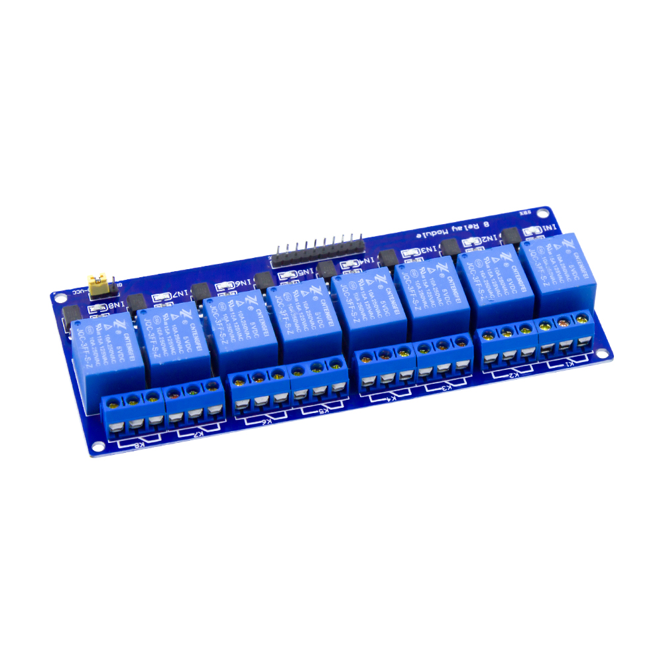

8 – Relay module
8 Relays : R1, R2, R3, R4, R5, R6, R7, R8
Three pins : NO, C, NC

Slide 19

D-LATCH BOARD
SN74LS373N
20 pin DIP IC
Input pins
Output pins
OE – active low
LE - high
3 | 4 | 7 | 8 | 13 | 14 | 17 | 18
D0 | D1 | D2 | D3 | D4 | D5 | D6 | D7
2 | 5 | 6 | 9 | 12 | 15 | 16 | 19
O0 | O1 | O2 | O3 | O4 | O5 | O6 | O7

Slide 20
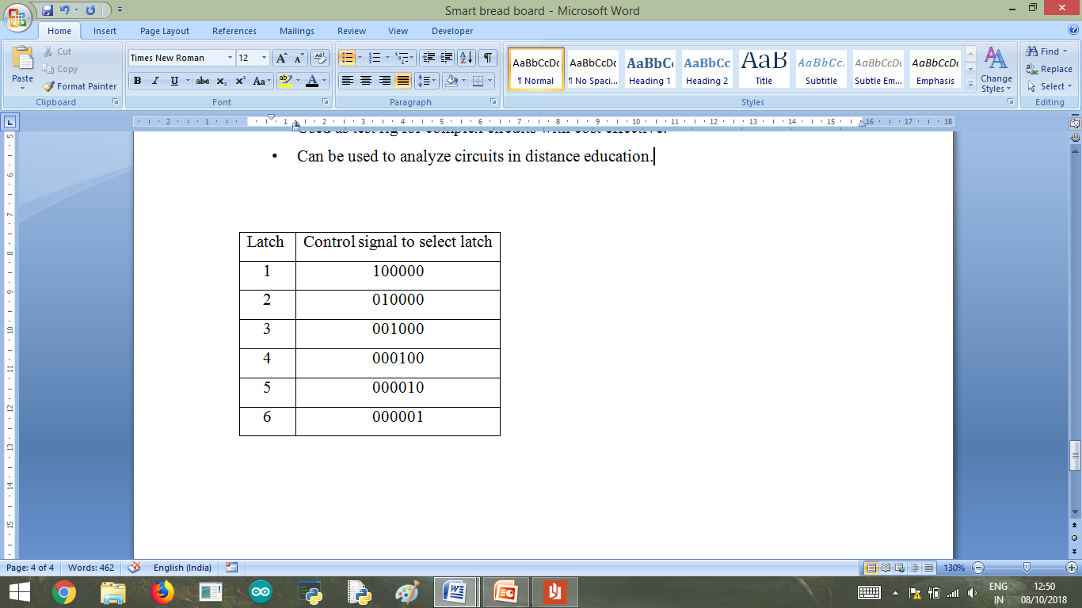
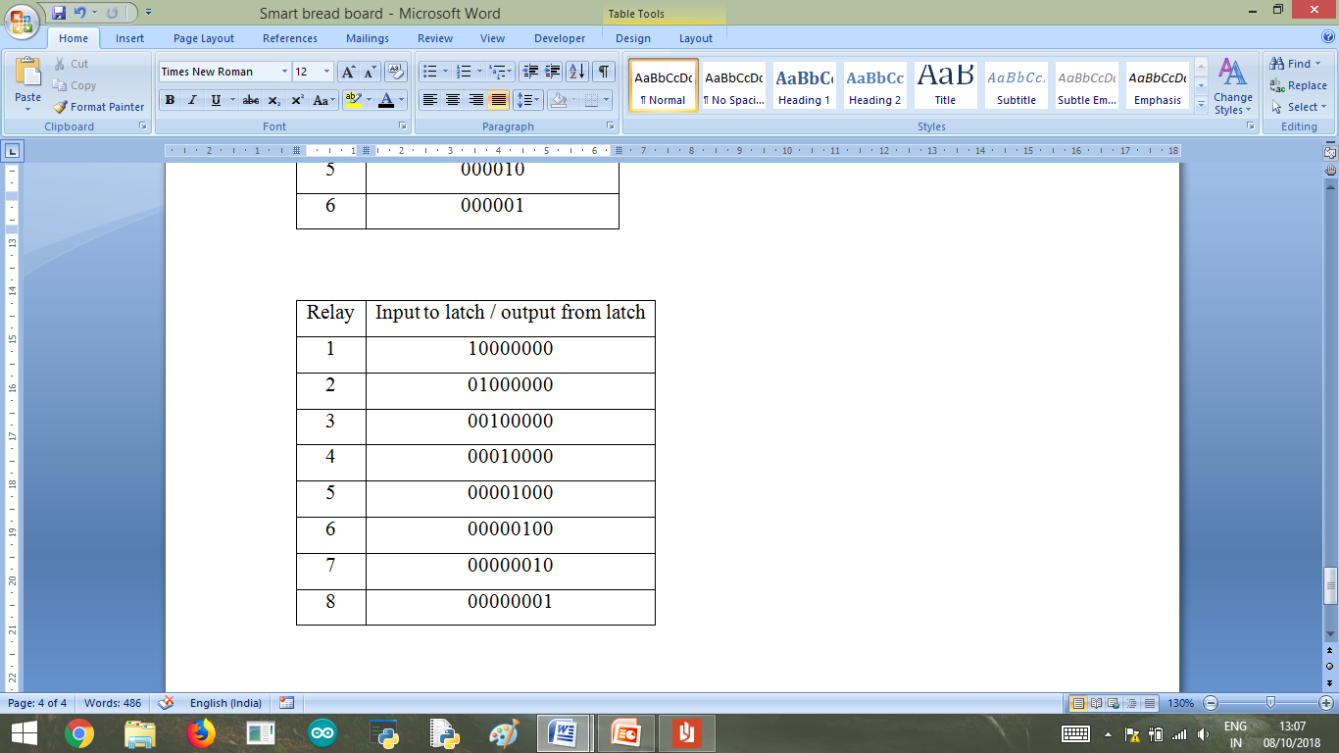

Slide 21
Advantages and Applications
Simplicity in making circuits as it saves time due to easy rig up in PC
Can be operated from the remote place
Small scale R&D industries can use to avoid time and cost
Can be used as rapid prototyping of circuits
Used as test rig for complex circuits with cost effective.
Can be used to analyze circuits in distance education and R&D purpose.

Slide 22
CONCLUSION
At the server end, the circuit is rigged up in a smart way without any human intervention
Output is made visible to the client with the help of video conferencing.
This feature of testing and analyzing the circuits virtually, from the remote place is said to be virtual electronics lab.
Worked on GUI features of python for the development of API.
Design of circuits in multisim software and generation of netlist.
Accessing and sending of netlist using python.
Rig up of smart bread board – Arduino, latches, relays, bread board and components.

Slide 23


